Slide 1
Web Development Tools
Mr Mack 2021

Slide 2
Using the browser developer tools
Web development is tricky. That's why web developers use lots of tools to help them with their jobs—and they're always looking for new tools to add to their toolbox.
The browser developer tools which are included in most modern browsers are a big favorite of most developers. Each browser differs in exactly which tools they provide, but they're more similar than they are different.

Slide 3
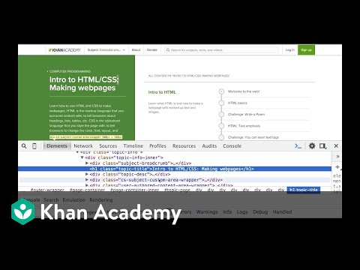
Inspecting HTML
One great tool is the ability to right click on any element on a webpage and inspect the HTML for that element. Here's a video of how to do that in Chrome:

Slide 4
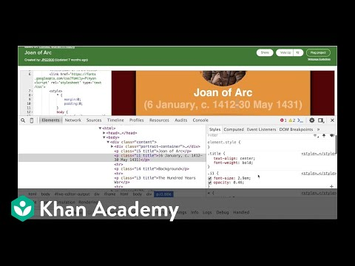
Inspecting CSS
Another useful tool is the CSS inspector; with this tool, you can check out which styles gets applied to an element and play with them yourself. Here's a video showing how to use this tool in Chrome:
Notes:
These tools can both help you understand the structure of other websites and help you debug your own websites.
There are lots more tools as well, but those two will give you a great start to being a better web developer. Try inspecting an element on this webpage and see what you find out!

Slide 5
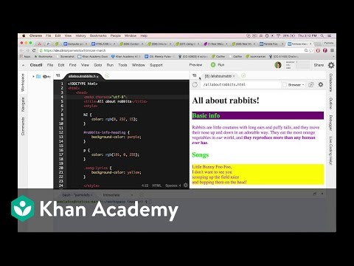
Online editors
One option is to use an online editor, similar to ours but with additional features. You might want to use an online editor if you have a computer that doesn't let you download apps or you want to use the same editor across multiple computers. Popular online editors are JSBin, Repl.it, Glitch, and CodePen. If you're on a ChromeBook, you can install a Chrome web app like Caret or Zed. Here's a video of me editing a webpage in Cloud9:

Slide 6
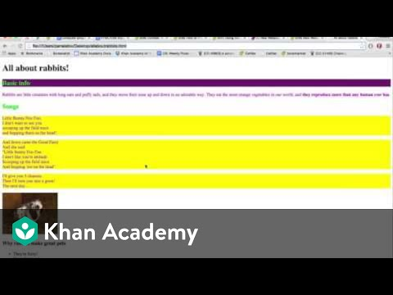
Desktop editors
Another option is to use a desktop editor. An app is downloaded to your computer and saves the files to your hard drive. There are lots of desktop editors for you to pick from, depending on what OS and price you're looking for. Some popular desktop editors are Visual Studio Code, Atom, Sublime Text, Adobe Brackets, and Notepad++ (for Windows). Here's a video of me editing a webpage in Sublime Text:

Slide 7
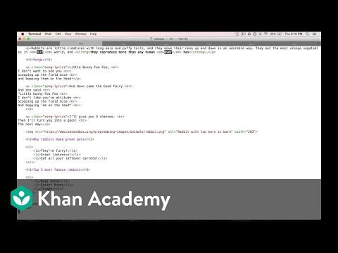
Command-line editors
A third option is to use a command-line editor. If you're not already familiar with the command line, you probably don't want to go down this route since you'll also need to learn a lot about the command line first. On the other hand, if you love typing and navigating with your keyboard instead of your mouse, you might find you love command-line tools. Two popular command-line editors are Emacs and Vim, and they are often already installed on Unix-based systems like Macs and Linux. Here's a video of me editing a webpage in Vim:

